Slide 1
B’ class School Objects [2]

Slide 2
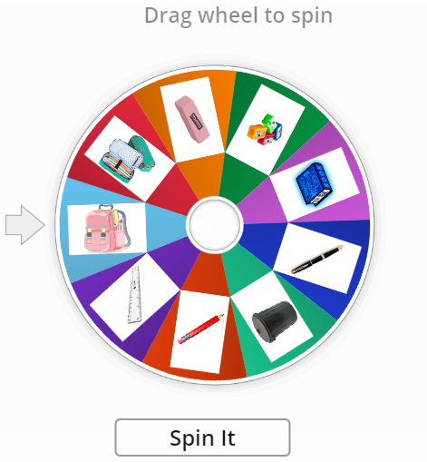
Let’s remember the school objects we learned so far.
https://wordwall.net/resource/6984244/school-objects

Slide 3
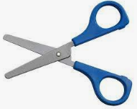
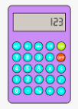
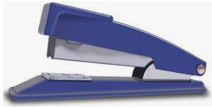
paper
Let’s learn some more school objects!
pencil crayon
crayon
glue
scissors
eraser/ rubber
calculator
stapler
marker

Slide 4
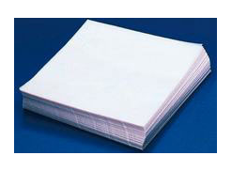
Now, let’s practice our new school objects with flashcards!
https://quizlet.com/509456629/b-class-school-objects-2-flash-cards/

Slide 5
Let’s help the monster put all the school objects in his bag!
I have a …… What do you have? Put it in my bag!

Slide 6
Let’s do a school objects quiz!
https://wordwall.net/resource/625126/school-objects

Slide 7
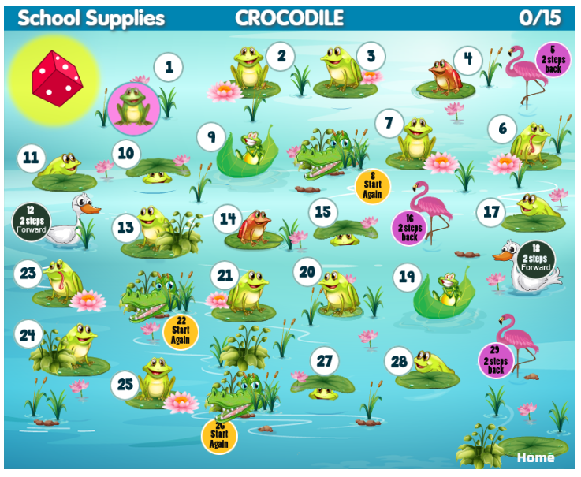
You can go to our e-class to play the school objects crocodile game!
https://www.eslgamesplus.com/school-supplies-esl-interactive-vocabulary-crocodile-board-game/

Slide 8
Great work everyone! See you next time!

